Slide 1
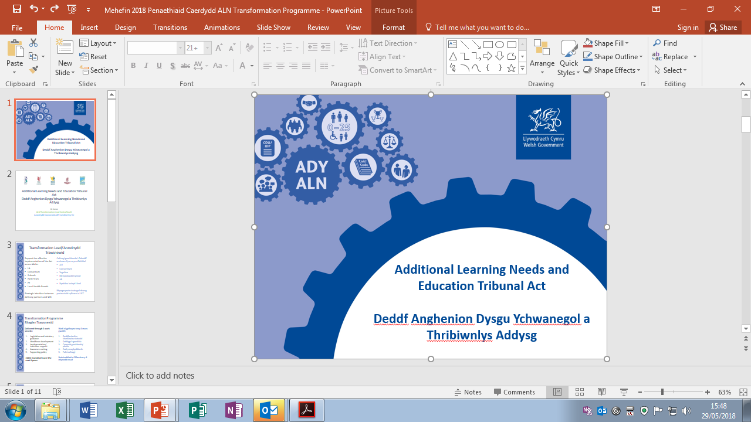
Additional Learning Needs and
Education Tribunal [Wales]
We see the implementation of the Act as an opportunity to modernise and work towards integrated working between local authorities (LAs), further education institutions (FEIs), early years settings and health boards, building on some excellent practice already in place.
By focussing on agreed needs and planned activity to meet those needs, the new system aims to improve outcomes for learners with ALN.
The vison and principles of the Act also support improving the capacity and capability of educational settings to create rich and inclusive learning environments that enable learners to engage fully, participate in decisions and feel a sense of belonging.

Slide 2
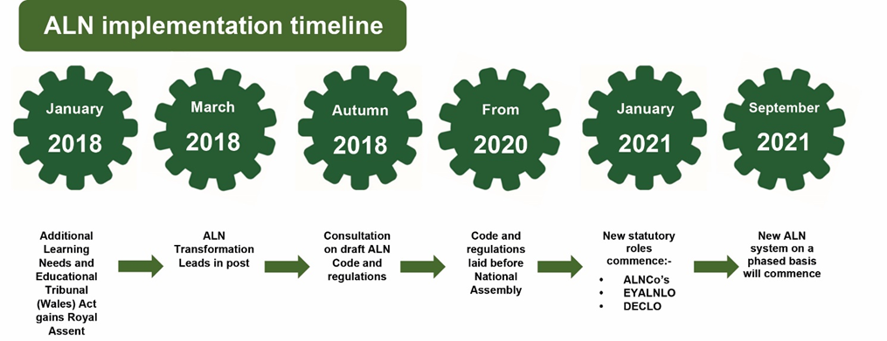
The new timeline for implementation of the Act is as follows:
From September 2021 until September 2024 the duties of the new Act and Code will be introduced in a phased way. During this time the duties under the Education Act 1996 will also remain in place for those cohorts of learners with special educational needs (SEN) to which it applies.

Slide 3





Aims of the Additional learning Needs and Education Tribunal Act (Wales) 2018
The Welsh Government has stated the following broad aims of the Act:
SEN to ALN
We will be using the term ‘additional learning needs’ rather than ‘special educational needs’.
All schools will have an Additional Learning Needs Co-ordinator (ALNCo).
Children or young people have an additional learning need when:
they have a significant difficulty or disability that means they need targeted and sustained support;
they find it much harder to learn than children or young people of the same age nationally;
they have a disability that means they cannot use their local school or college.
Disagreement Resolution and Rights of Appeal
Whenever possible, disagreements will be dealt with as quickly as possible with the school and the key people involved.
An appeal is when you request that a decision be changed.
Independent support groups will be able to listen and help if there are disagreements which cannot be resolved. Children, young people, parents and carers have the right to appeal decisions made by the school and the Local Authority about the child or young person’s additional learning needs or additional learning provision.
Belief in an inclusive and equitable system where the needs all of can be met to ensure successful, independent and resilient children and young people
0-25 Years Old
Children or young people with ALN will have one system of support from the age of 0 to 25 years old.
Participation of Children and Young People
What children and young people think, feel and would like will be central in our planning. The children and young people will be part of developing their Individual Development Plans.
Collaboration
The thoughts, feelings and wishes of parents and carers will be gathered as an on-going process. Where relevant schools will work with health, social services and anyone else who supports the child or the young person.

Slide 4

Unified Plan (Individual Development Plan)
Children or young people identified as having an ALN that require additional learning provision will have an Individual Development Plan (IDP) to show their needs and the support in place.
Additional learning provision is support which is additional to that provided to the majority of children or young people of the same age.
The IDP will include the advice of a range of professionals supporting the child or young person (where relevant).
IDPs will be reviewed annually or when anything significant changes for the child or young person.
Individual development plans (IDPs) will replace the existing variety of statutory and non-statutory plans for learners of compulsory school age and below, and those over compulsory school age in school or further education.
Local authorities will normally only prepare and maintain an IDP in instances where the child or young person’s needs are more severe or complex. Ordinarily IDPs will be the responsibility of the maintained school or further education institution.

Slide 5
The Act places the learner at the heart of the process – Person Centred Practice
What does Person Centred mean?
It means focussing on your child.
How does your child contribute?
Your child will have their One Page Profile to show at the meeting, stating three key questions:
What people admire/like about me?
What is important to me?
How best to support me?
The school will prepare your child for the review and if appropriate they will attend. They can use symbols/photographs/write or in some cases a smart board will be used to demonstrate their achievements
What is a Person Centred Review?
It is all about:
Listening and understanding your child’s views and wishes.
Supporting your child to think about what is important to them and for them.
Helping your child to think what’s working and not working.
Making sure that your child gets the best support from everyone for example, you, the school and other professionals.
What will be discussed?
Who is present
What we admire and like about your child
What is important to your child
What is important for your child
What is working well/not working
Any questions
Action Plan

Slide 6

Further Information
ALN Transformation Programme - English
http://gov.wales/docs/dcells/publications/180124-aln-transformation-programme-en-v2.pdf
ALN Transformation Programme - Welsh
http://gov.wales/docs/dcells/publications/180124-aln-transformation-programme-cy-v2.pdf
Welsh Government – www.gov.wales/ALN
National Assembly for Wales – www.assembly.wales
Twitter #additionallearningneeds
Join up for e-mail updates
Additional learning needs transformation programme, Welsh Government
SENreforms@wales.gsi.gov.uk
The interactive e-learning course giving an introduction to the new ALN system is now available on the Welsh Government's Hwb platform.
Here is a Hwb news article introducing the course, which is currently on the Hwb homepage:
https://hwb.gov.wales/news/articles/20686965-8669-40ac-bdc5-599f4a4dfe8b
And here is the link to the course itself:
https://hwb.gov.wales/repository/publishers/9fb2afc9-6408-4aa3-9474-3c745006535b/resource/c8033263-aaa0-42fc-9511-ab7d33bd8084/en
Contact -SNAP Cymru for help with dispute resolution and advocacy support for children and young people https://www.snapcymru.org/
PCP Good practice films
Shane Hayes - https://www.youtube.com/watch?v=7KQOypic6ZE
Jonathan Bussy - https://www.youtube.com/watch?v=lJ3X4FkPmPU
John Lavender - https://www.youtube.com/watch?v=Ul88eggAPXc
Hayley Page/Cathy Wright - https://www.youtube.com/watch?v=LyKIW34bOgs
Gemma Bussy - https://www.youtube.com/watch?v=UgGx4NKQyyc
Dave Williams ABUHB DECLO - https://www.youtube.com/watch?v=xh9wRPSliA4
Cheryl Deneen - https://www.youtube.com/watch?v=SFfLqNJocgs
If you require any further information please contact your Inclusion team @.......

